Slide 1
Linkers

Slide 2

Linker
Steps for Execution:
1. Translation of program
2. Linking of program with other programs needed for its execution.
3. Relocation of the program to execute from the specific memory area allocated to it.
4. Loading of the program in the memory for the purpose of execution.

Slide 3
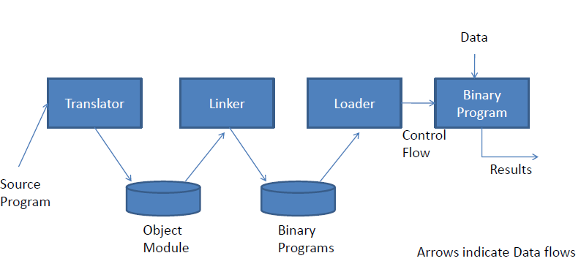

Slide 4
Linkers
Links with other programs needed for its execution
Processes a set of object modules to produce a ready-to-execute program form called binary program
Loader loads this program into memory for execution

Slide 5
Linker
A Linker is a system program that combines the code of a target program with codes of other programs and library routines

Slide 6
Object Module and Binary Program
Object Module:
Contains target code (Machine language) of the program and information about other programs and library routines that it needs to invoke during its execution
Binary Program:
Target code and other program routines combined together to form Binary program

Slide 7
Addresses
Address of a program entity may vary at different times:
Translation time address: Address assigned by translator (ORIGIN or START)
Linked address: Address assigned by linker
Load time address: Address assigned by loader

Slide 8
Addresses
Origin of a program may have to be changed by linker or loader because
Same set of translated addresses may have been used in different object modules, resulting in memory conflicts
OS MM module may require that a program should be allocated specific area of memory

Slide 9
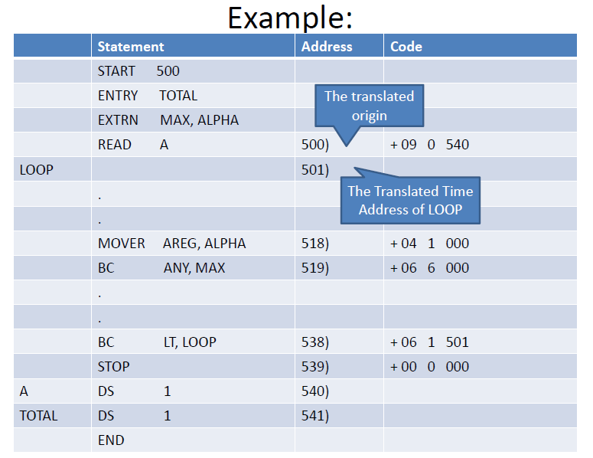

Slide 10
Relocation concept
Program relocation is the process of modifying the addresses used in the address sensitive instructions of a program such that the program can execute correctly from the designated area of memory
If linked origin ≠ translated origin, relocation must be performed by the linker
If load origin ≠ linked origin, relocation must be performed by the loader

Slide 11
Sample Assembly Language Program and generated code (Program P)
START 500
ENTRY TOTAL
EXTERN MAX,ALPHA
READ A 500 +400) 09 00 540+400=940
LOOP 501+400) 901
----
MOVER AREG, ALPHA 518+400) 918 04 01 000
BC ANY, MAX 519+400) 919 07 06 000
-----
BC LT, LOOP 538) 07 01 501
STOP 539) 00 00 000
A DS 1 540)
TOTAL DS 1 541)
END

Slide 12
Performing Relocation
t_origin_{p} - translated origin of program P
l_origin_{p} - linked origin of program P
t_{symb} - translation time address of a symbol symb
l_{symb} - link time address of a symbol symb
Relocation factor of P is defined as
relocation_factor_{p} = l_origin_{p} - t_origin ₋₋₋₋₋₋₁

Slide 13
Performing Relocation
relocation_factor_{p} = l_origin_{p} - t_origin ₋₋₋₋₋₋₁
t_{symb} = t_origin_{p} + dsymb -----2
l_{symb} = l_origin_{p} + dsymb -----3
From 1 and 3
l_{symb} = t_origin_{p} + relocation_factor_{p} + d_{symb -----4}
From 2 and 4
l_{symb} = t_{symb} + relocation_factor_{p -----5}

Slide 14
For Program P:
Translated origin is 500
Suppose l_origin = 900
Relocation_factor = 900- 500 = 400
Relocation will be performed for instructions with translated time address 500 and 538
For instruction with translated time address 500: address 540 in operand field will change to (540+400) = 940
For instruction with translated time address 538: address 501 in operand field will change to (501+400) = 901

Slide 15
Linking
Program interacts with another program unit using its instructions & data in its own instructions
Public definitions & external references required
ENTRY: Public definitions
A symbol defined in a program unit that may be referenced in other program unit.
EXTRN: External references
A reference to a symbol that is not defined in the program unit containing the reference (defined in other program)
Linking is the process of binding an external reference to the correct link time address

Slide 16
Program Q
START 200
ENTRY ALPHA
--
ALPHA DS 25 231) 00 00 025
END

Slide 17
Linkers
Object module contains all info necessary to relocate & link program with other programs
Header : has translated origin, size & execution start address
Program : has machine code
Relocation table (RELOCTAB) : each entry contains translated address of an address sensitive instruction
Linking table (LINKTAB): contains PD/EXT symbols
Linker generates the linked addresses of all the symbols & instructions

Slide 18
RELOCTAB and LINKTAB
Program P:
RELOCTAB:
500) 09 00 540
538) 07 01 501
LINKTAB:
TOTAL PD
MAX EXT
ALPHA EXT

Slide 19
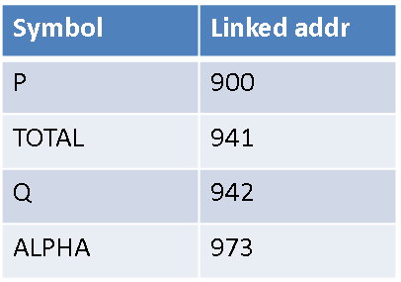
RELOCTAB and LINKTAB
Program Q:
LINKTAB:
ALPHA PD
NTAB:

Slide 20
Linking of Program P and Q
Program P:
START 500
ENTRY TOTAL
EXTERN MAX,ALPHA
READ A 900) 09 00 940
LOOP 901)
----
MOVER AREG, ALPHA 918) 04 01 973
BC ANY, MAX 919) 07 06 000
-----
BC LT, LOOP 938) 07 01 901
STOP 939) 00 00 000
A DS 1 940)
TOTAL DS 1 941)
END
Program Q:
START 200
ENTRY ALPHA
-- 942)
ALPHA DS 25 973) 00 00 025
END

Slide 21
Self-Relocating Programs
Programs can be classified into
Non relocatable programs
- cannot be executed in any memory area other than its translated origin
-due to lack of information pertaining to address sensitive instructions in program
2. Relocatable programs
- Has info available related to address sensitive instructions in program
3. Self-relocating programs

Slide 22
Self-Relocating Programs
Performs relocation of its own address sensitive instructions
2 provisions for this
1. Table containing address sensitive instructions
exists as part of program
2. Relocating logic: Code to perform relocation of address sensitive instructions also exists as part of program
Can execute in any area of memory
Useful in time sharing operating systems

Slide 23
Static Link Libraries
Is the process of copying all library modules used in the program into the final executable image.
This is performed by the linker and it is done as the last step of the compilation process.
The linker combines library routines with the program code in order to resolve external references, and to generate an executable image suitable for loading into memory.
When the program is loaded, the operating system places into memory a single file that contains the executable code and data.
This statically linked file includes both the calling program and the called program.
Statically linked files are significantly larger in size because external programs are built into the executable files.

Slide 24
Static Link Libraries
If any of the external programs change then they have to be recompiled and re-linked again else the changes won't reflect in existing executable file.
Statically linked program takes constant load time every time it is loaded into the memory for execution
Programs that use statically-linked libraries are usually faster
In statically-linked programs, all code is contained in a single executable module. Therefore, they never run into compatibility issues.

Slide 25
Dynamic Link Libraries
In dynamic linking the names of the external libraries (shared libraries) are placed in the final executable file while the actual linking takes place at run time when both executable file and libraries are placed in the memory.
Several programs use a single copy of an executable module.
Is performed at run time by the operating system
Only one copy of shared library is kept in memory. This significantly reduces the size of executable programs, thereby saving memory and disk space
Individual shared modules can be updated and recompiled. This is one of the greatest advantages dynamic linking offers.

Slide 26
Dynamic Link Libraries
Load time might be reduced if the shared library code is already present in memory.
Programs that use shared libraries are usually slower than those that use statically-linked libraries.
Dynamically linked programs are dependent on having a compatible library. If a library is changed (for example, a new release may change a library), applications might have to be reworked to be made compatible with the new version of the library. If a library is removed from the system, programs using that library will no longer work.

